Slide 1
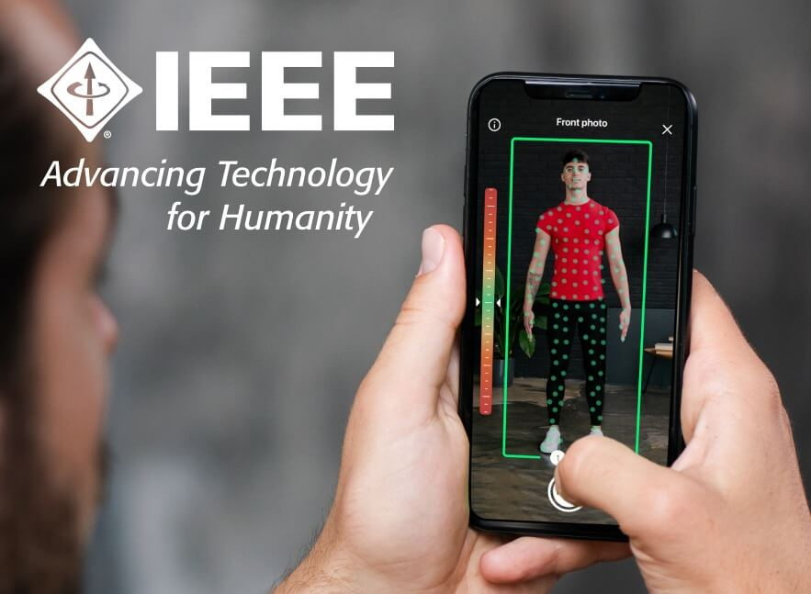
VIRTUAL CLOTHING SYSTEM
virtual fitting and styling solution
Notes:
Line spacing + Page numbers

Slide 2
01
OBJECTIVE OF THE PROJECT
We have built web-base body scanning and measuring technology which enables to measurement of their body , get right size clothes and apply body data to wearing clothes virtually which will reduces time by having virtual trail instead of having a real trail for clothes.
The project providing a contactless and personalized fit experience for consumers, drive down returns and inventory, and apply body data to the apparel supply chain to create a more sustainable business model to help optimize processes, cut costs, and deliver better shopping experiences
Let your customers try on clothing, style outfits and find their perfect fit. Boost conversions, reduce returns and elevate your e-commerce experience
01
02
03

Slide 3
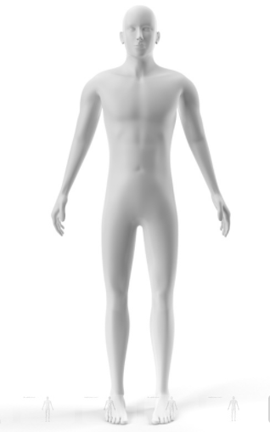
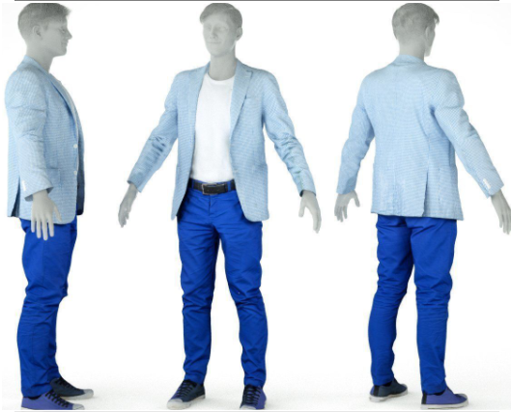
Introduction
02
We have built web-base body scanning where they have 3 step .
01 Scanning
02 Create model
03 Virtual trials

Slide 4
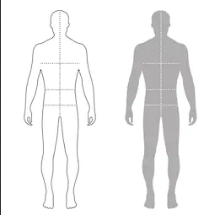
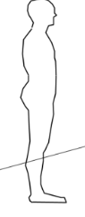
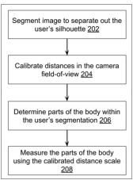
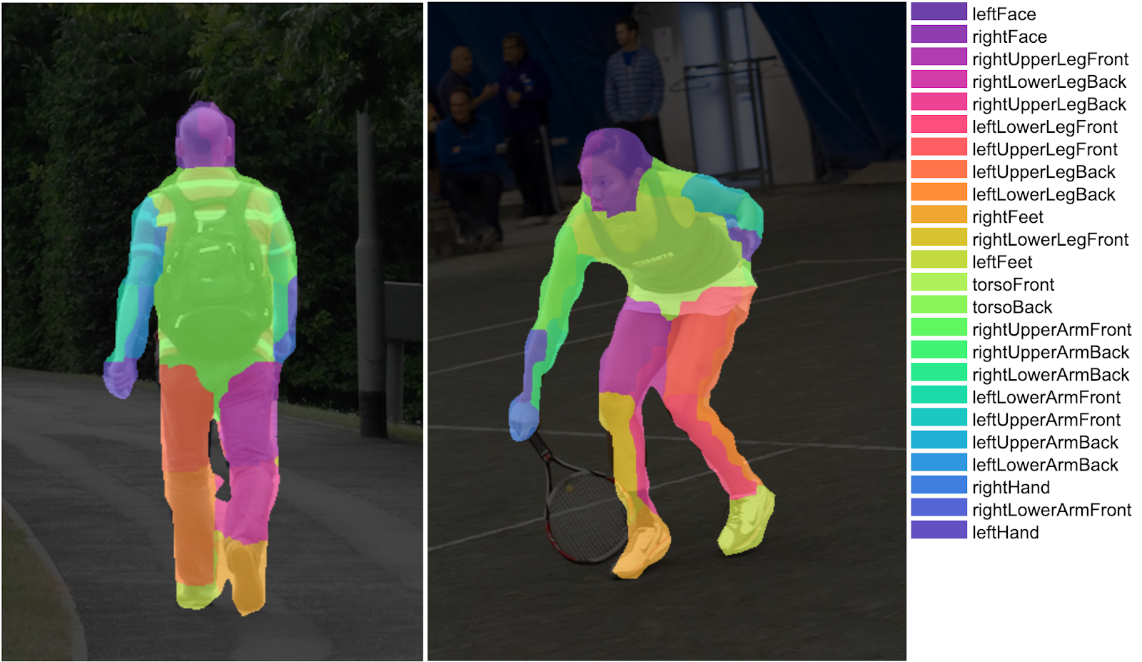
Scanning
This step is used for getting the size of body such as chest, waist, leg, etc. buy scanning the body whit camera.
Process and challenges
The challenges is to identify the distance between the camera and the person to solve this we have 2 approach one is to get the user’s height and another is to use chess board .
Get 2 image from front and side view
Then we segment the image calibrate the camera and filed view , determined the pat of the body with in the segment (bodypix).
The measure the part of the body by the technique,
known body ratios, e.g., head-to-height ratio, waist-level-to-height ratio, inseam-to-height ratio, etc., are used to approximately identify parts of the body such as chest, waist, leg, etc.

Slide 5
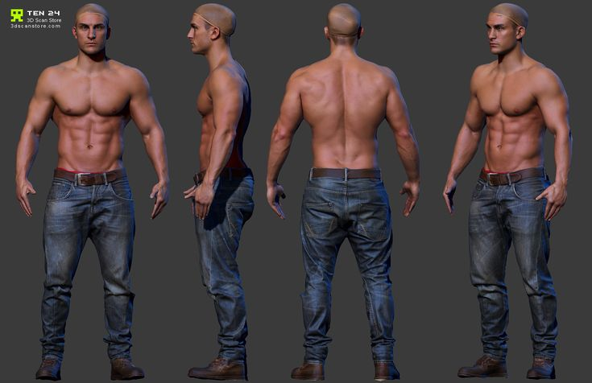
Create model
In this part we create the demo 3D model size of same as the person scanned and virtual cloth so that the person get an idea how he /she look after the wear of cloth
Process and challenges
The challenges is to create web base application which support 3D model ( 360 deg view) and our approach one to use three.js which help to cerate model with good performance.
In this step we get human data from previous step and with this date we dynamical generate the model suitable for the user
We can change the different dress and trial virtually will save time by having virtual trail instead of having a real trail for clothes
And we can reduce the connate of the dress to prevent the spread of virus like ( covid-19)

Slide 6
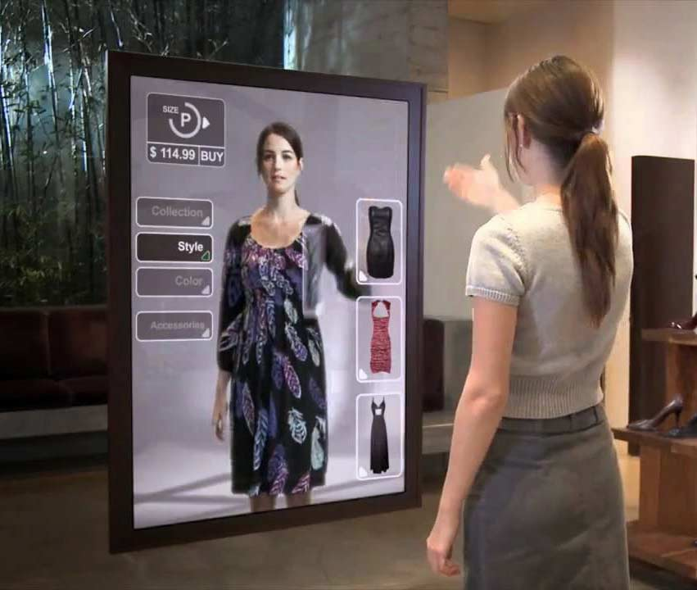
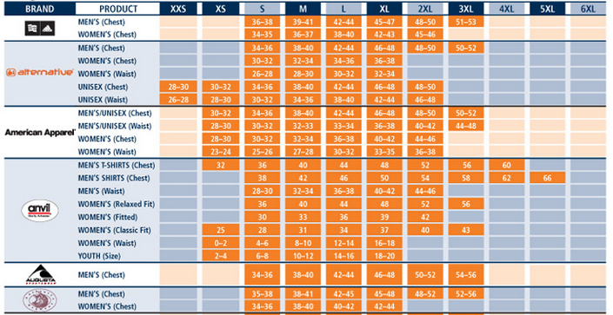
PROJECT FEATURES
03
Measurement:
Easy way to measure the human body .
Can measure the size by their own and reduce time .
Virtual fitting room :
Can change their clothes virtually and get the idea how they look after wear it.
They can have a virtual trail on 3d character , no need for physical trail
Reduce the size problem:
This is particularly a problem because different cloth brands define sizes (e.g., small, medium, large, etc.) differently. For example if mr.x have 30 cheast size then xxs , xs , s are the size depend on Brands .

Slide 7
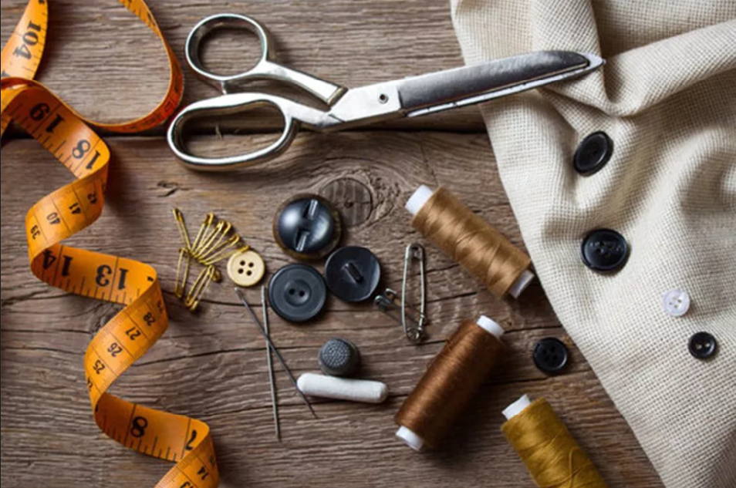

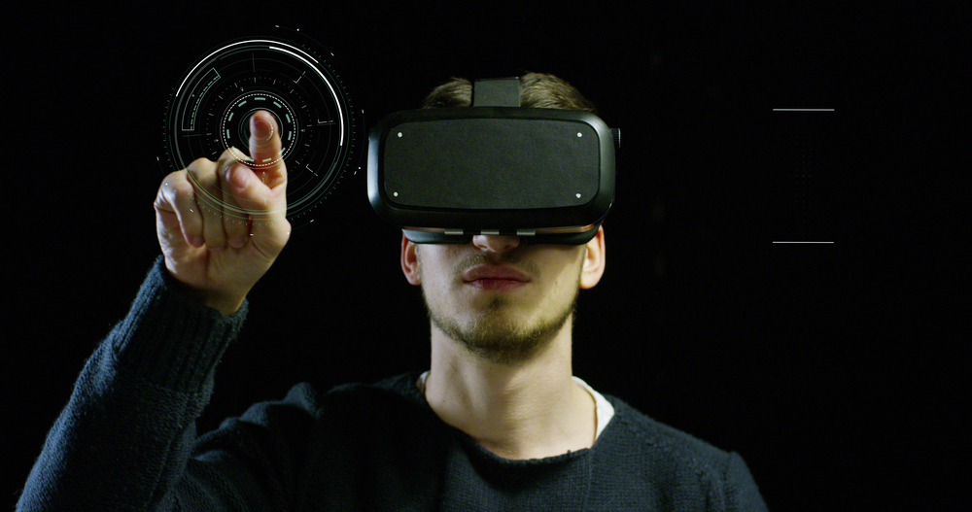
APPLICATION OF THE PROJECT
04
This project can help for tailor to get the measurement of customer remotely and increase the productivities . So that they get the measurement of customer without contact to human.
Technology providing a contactless and personalized fit experience for consumers, drive down returns up to 37% which reduce the cost of retuning (pickup and Deliver charges ) and customer have a open mind for the new fashion with great customer satisfaction and inventory.
Apply body data to the apparel supply chain to create a more sustainable business model
We have built web-base body scanning and measuring technology which enables a simple exchange of measurement and shape data between your vender to help optimize processes, cut costs, and deliver better shopping experiences
Maintain dress and select which outfit is best for you .

Slide 8






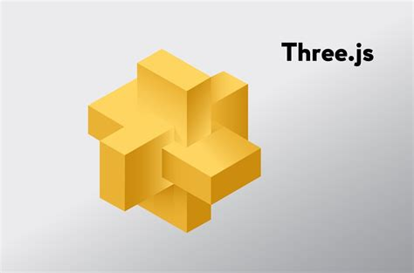
TECHNOLOGIES USED
05
Front-End : ReactJS
Server : NodeJS
Database : mongo DB
Libraries :
TensorFlow JS
Three JS
Web GL
Face-Api JS
Language :
Java script

Slide 9
06
EXPECTED OUTCOME OF THE PROJECT
The final output expecting as a 3d model of user with perfect outfit virtually .
REFERENCES
[Updated] BodyPix: Real-time Person Segmentation in the Browser with TensorFlow.js

